Slide 1
Developing a Machine Learning Model to Predict Student Dropout Rates or Academic Success
Syed Affan

Slide 2
THE PROJECT
The goal of the project was to develop a machine learning model to predict student dropout rates or academic success based on various factors.
I developed a model that achieves higher accuracy than the initial baseline model. The final model has an ROC score of 92%.
Feature engineering and analysis of feature importance helped identify the most important factors contributing to student dropout rates or academic success.
I used tree-based models for the project due to the nature of the data.
I deployed the final model on Hugging Face as an end-to-end solution that can be used by schools and educational institutions to identify at-risk students and provide targeted interventions and support.

Slide 3
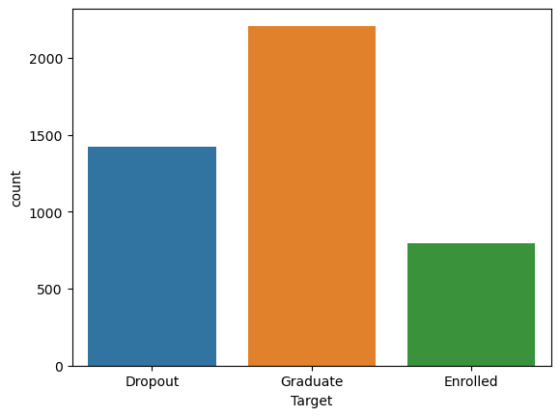
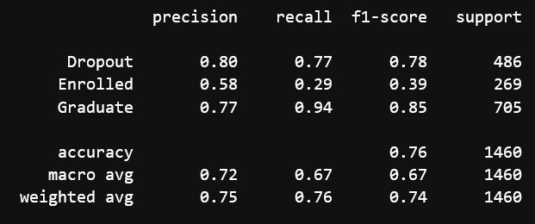
The Dataset

Slide 4
THE MODEL
Multidimensional Dataset
Label Encoded
SVC
RandomForest

Slide 5
DEALING WITH ‘ENROLLED’
DROP ‘ENROLLED’:
ROC_SCORE: 0.8875817644422441

Slide 6
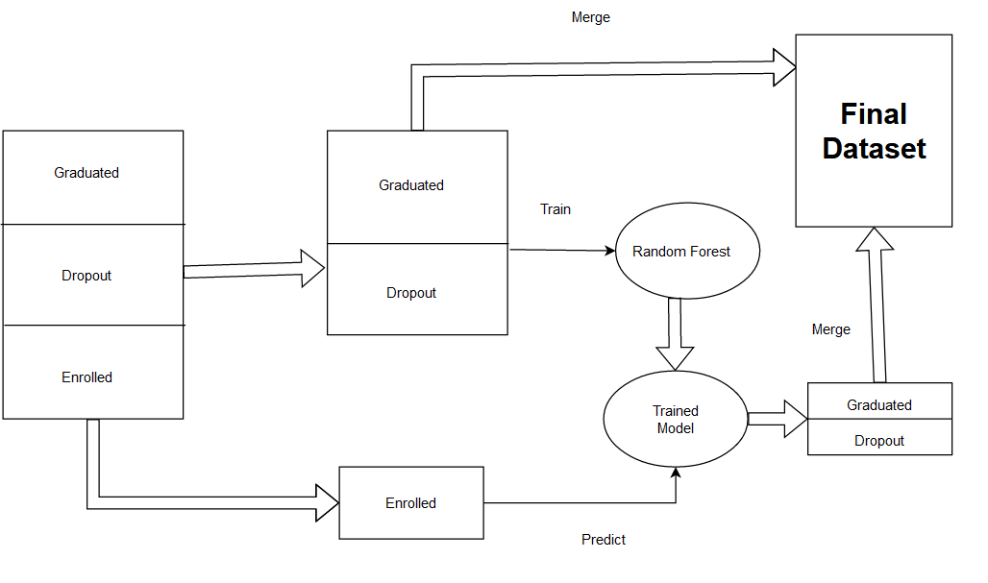

Slide 7
DEALING WITH ‘ENROLLED’
DROP ‘ENROLLED’:
ROC_SCORE: 0.8875817644422441
CONVERT ‘ENROLLED’
ROC_SCORE: 0.9147091391202245

Slide 8
PLATEAU
Counting Encoder: Replace the Label Encoded Values with the frequency with which the particular value appears. Is normally very useful for tree based models.
Feature Engineering: Replaced highly correlated features, and unimportant features. Extremely Limited Success.

Slide 9
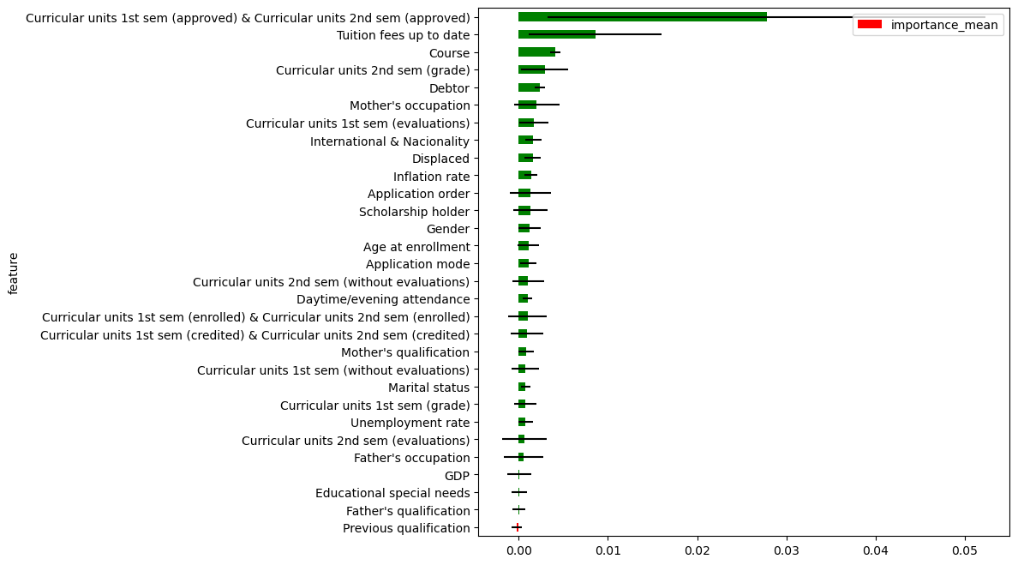
FEATURE IMPORTANCE

Slide 10
Model Deployment
sulpha/student_academic_success · Hugging Face
The model can be used by anyone

Slide 11
PAPER
IN PROGRESS

Slide 12
THE END
Any Queries?

